Slide 1
Scraping and API Calls

Slide 2
Scraping
Makes use of DOM of webpages
Beautiful Soup
Takes URL or html file
Parses html into a tree

Slide 3
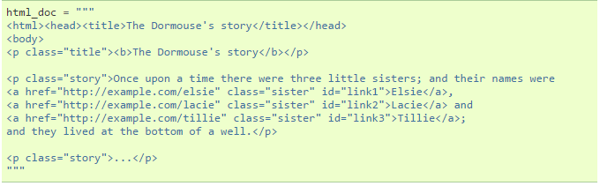

Beautiful Soup

Slide 4
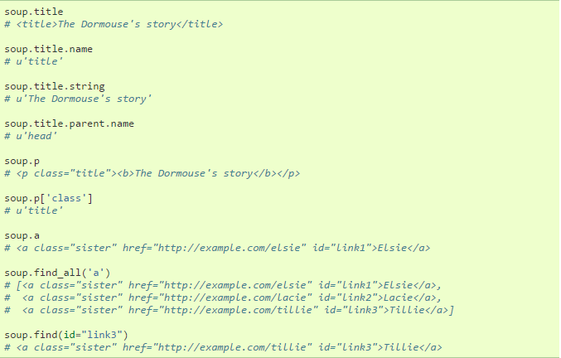

Slide 5
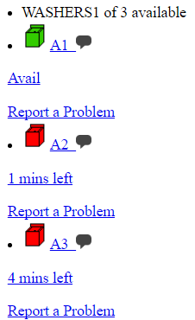
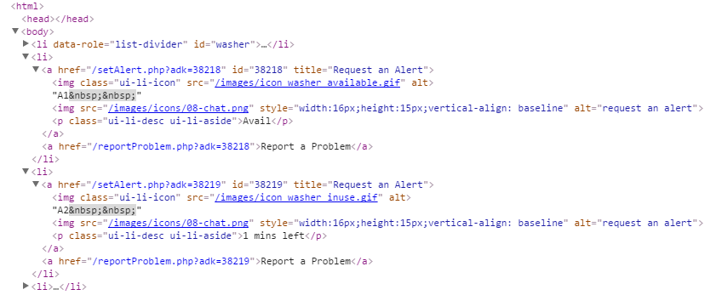

Slide 6
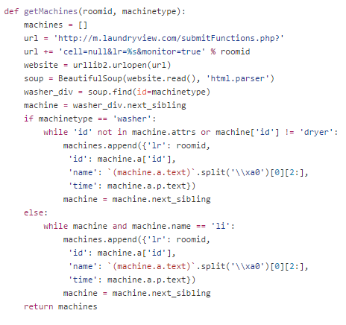

Slide 7
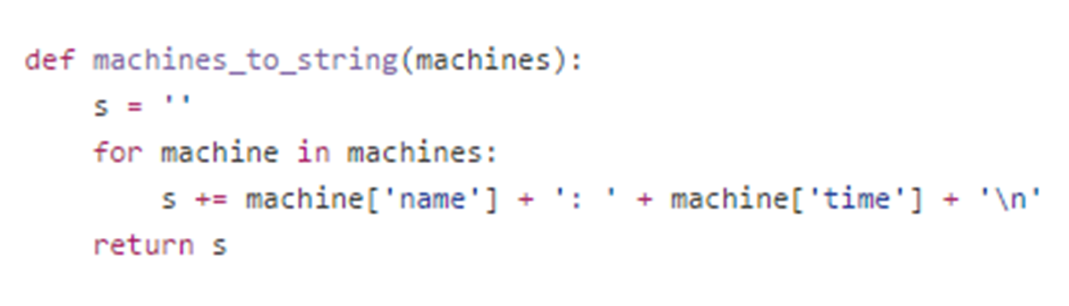

Slide 8
API Calls
Building blocks to use other people’s code
Shuttle Timers
Transloc
Calls for stops and routes

Slide 9
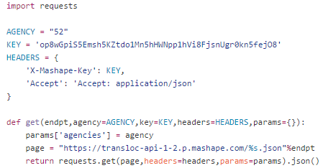

Slide 10
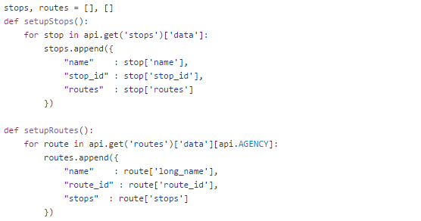
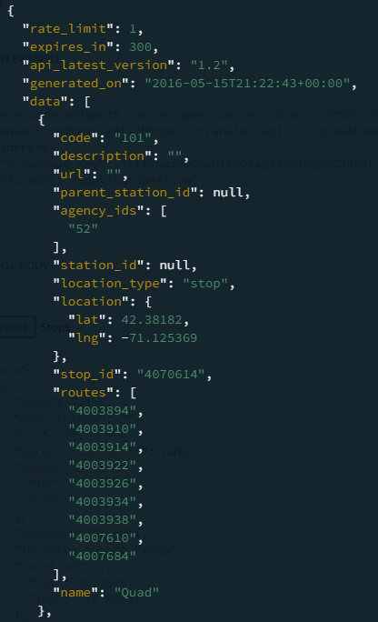

Slide 11
